Slide 1

INTRODUCTION
The project is a Product Management System (PMS) designed for managing product data efficiently. It allows users to create, read, update, and delete (CRUD) product records, including details such as price, ads, taxes, discounts, and category.

Slide 2
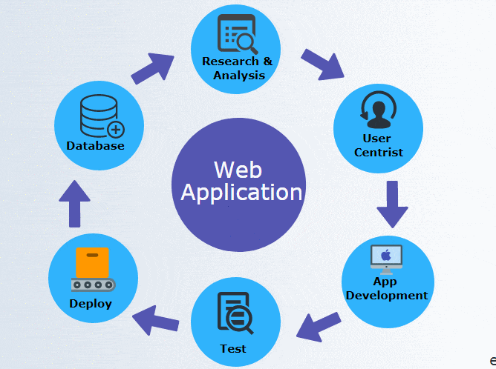
Features | how does it work
✔ Add Products | Users can input product details and save them to the database
✔ View Products | Displays a table of all stored products dynamically fetched from MongoDB.
✔ Edit Products | Allows users to update existing product information.
✔ Delete Single Product | Removes a product from the database and updates the UI.
✔ Delete All Products | Clears the entire product list with one click.
✔ Search Functionality | Search by title or category to filter products in real-time.
✔ Automatic Calculations | The system dynamically calculates the total price based on taxes, ads, and discounts.

Slide 3
why we choose this project
The Product Management System (PMS) was chosen as our project because it provides a real-world application of CRUD (Create, Read, Update, Delete) operations while also helping us develop full-stack development skills. the key reasons why we selected this project:
1️⃣ Practical and Real-World Use Case
2️⃣ Perfect for Learning CRUD Operations
3️⃣Full-Stack Development Experience
4️⃣ Implementing Real-Time Search and Filtering

Slide 4
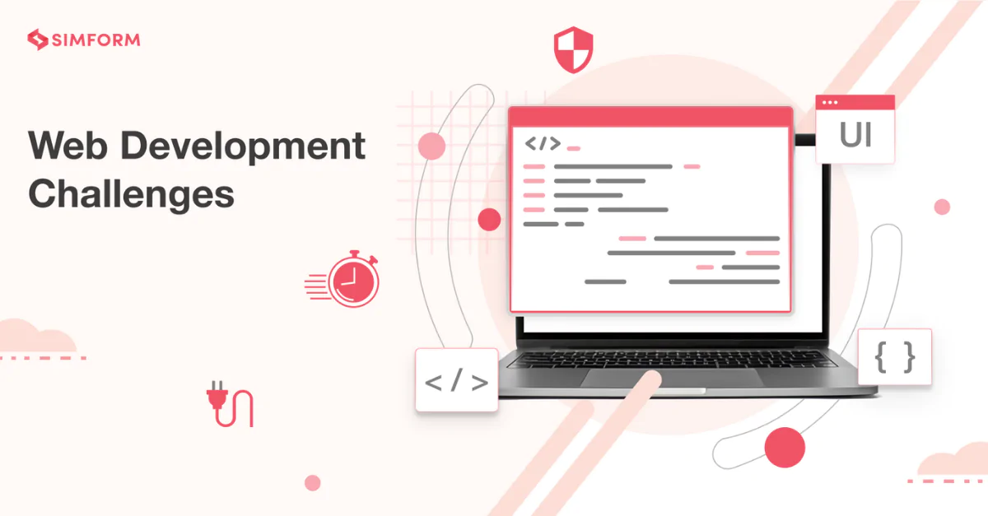
Technical Challenges
Search Functionality Not Working
🔹 Challenge:
The project had a search by title/category, but after applying it to MongoDB, the function broke.
The UI did not update properly when filtering products.
✅ Solution:
Restored GetSearchMood() to set search mode (title/category).
Implemented a JavaScript filtering function to update the product list dynamically.

Slide 5

Technical Challenges cont.
Ensuring Data Consistency in MongoDB
🔹 Challenge:
Some products were duplicated due to the count field allowing multiple entries.
Users expected all products to be stored individually.
Solution:
Looped count when saving products to ensure multiple records are created properly

Slide 6

biggest mistake we made during this project
One of the biggest mistakes we made was initially designing the system to work only with Local Storage. When transitioning to MongoDB, we faced several unexpected challenges that could have been avoided if we had planned for a database-driven approach from the beginning.
we faced logic errors , UI not updating properly after CRUD operations.
The transition from Local Storage to MongoDB was a valuable learning experience. Now, the system is scalable, database-driven, and properly structured. If we build a similar project in the future, we will plan for database integration from the beginning!

Slide 7
Product Management System (PMS)
The project was made by :
بدر فهد المسعود | 443017986
خالد وليد الصنيدح | 443016780
خالد نافع هوسه | 443016589
عبدالله حمدان الدوسري | 444002393

Slide 8
Thank you
any questions ?

